Slide 1
Machine Learning :
Classification Models
Nachiketh

Slide 2
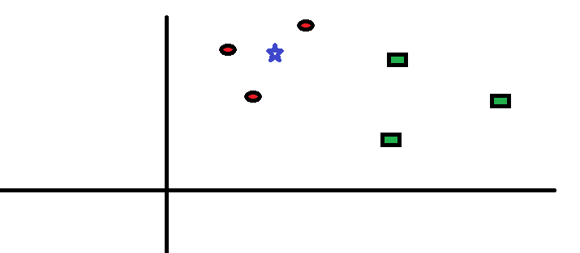
KNN
The “K” is KNN algorithm is the nearest neighbor we wish to take the vote from

Slide 3
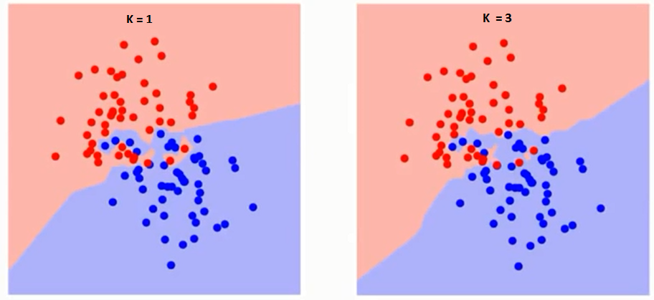
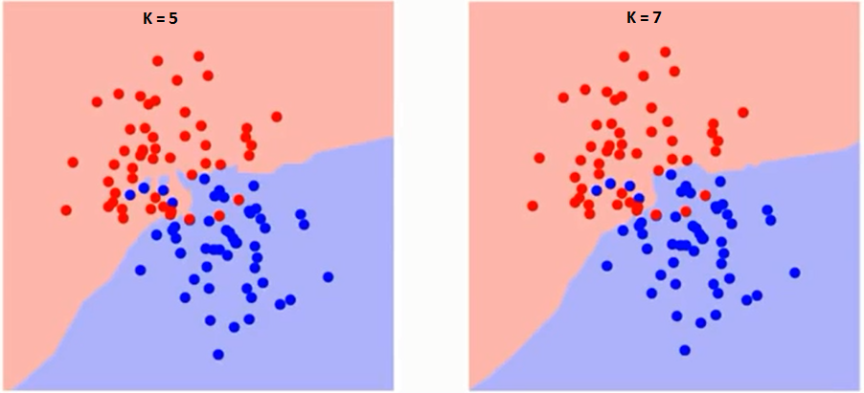
K = ?

Slide 4
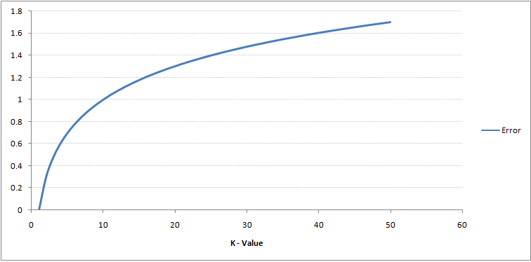
K-value Vs Error

Slide 5
Pros of KNN
No assumptions about data — useful, for example, for nonlinear data
Simple algorithm — to explain and understand/interpret
High accuracy (relatively) — it is pretty high but not competitive in comparison to better supervised learning models
Versatile — useful for classification or regression

Slide 6
Cons of KNN
Computationally expensive — because the algorithm stores all of the training data
High memory requirement
Stores all (or almost all) of the training data
Prediction stage might be slow (with big N)
Sensitive to irrelevant features and the scale of the data

Slide 7
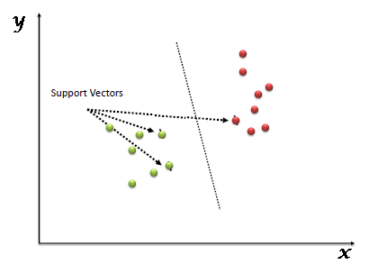
SVM
In the SVM algorithm, we plot each data item as a point in n-dimensional space (where n is number of features you have) with the value of each feature being the value of a particular coordinate. Then, we perform classification by finding the hyper-plane that differentiates the two classes very well

Slide 8
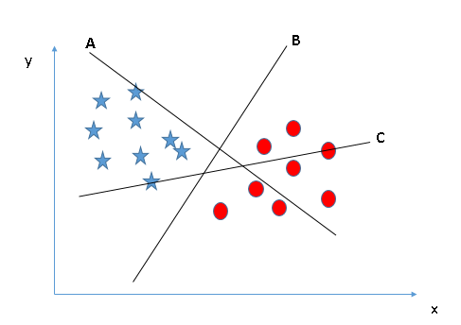
How does it Work?

Slide 9
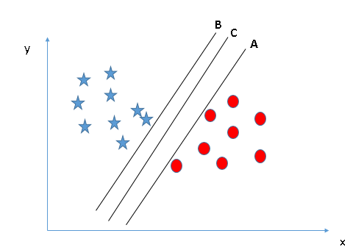
Which is Best?

Slide 10
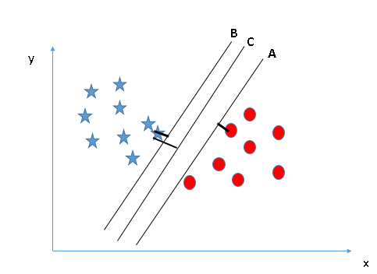
Which is Best?

Slide 11
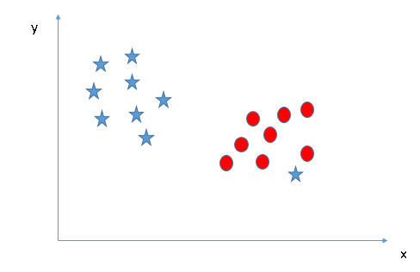
How do System perform separation

Slide 12
Types of Kernel
Linear Kernel
K(x, xi) = sum(x * xi)
Polynomial Kernel :
K(x,xi) = 1 + sum(x * xi)^d
Where d is the degree of the polynomial. d=1 is similar to the linear transformation. The degree needs to be manually specified in the learning algorithm.
Radial basis Kernel
K(x,xi) = exp(-gamma * sum((x – xi^2))
Here gamma is a parameter, which ranges from 0 to 1. A higher value of gamma will perfectly fit the training dataset, which causes over-fitting. Gamma=0.1 is considered to be a good default value. The value of gamma needs to be manually specified in the learning algorithm.

Slide 13
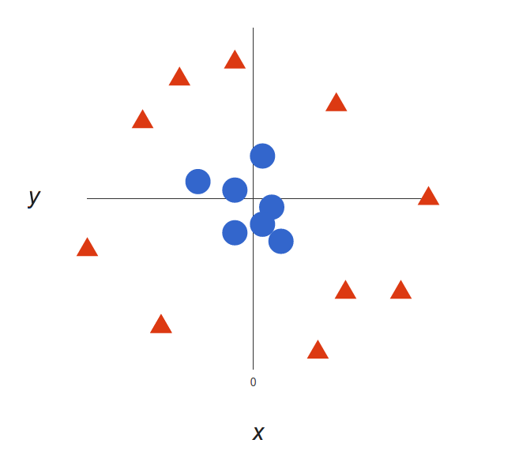
What happens with non-linear data ?

Slide 14
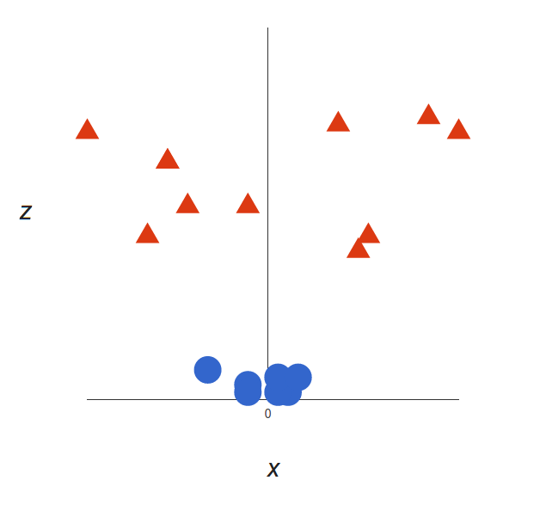
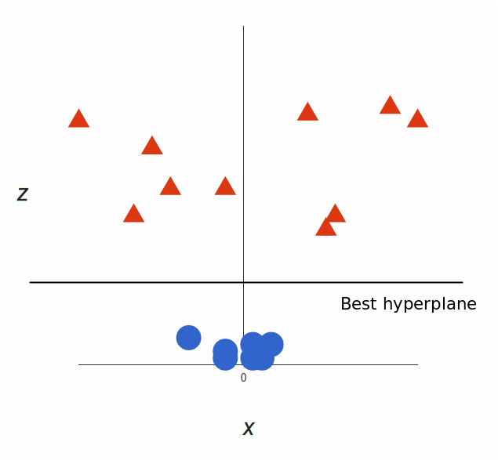
Add a new dimension

Slide 15
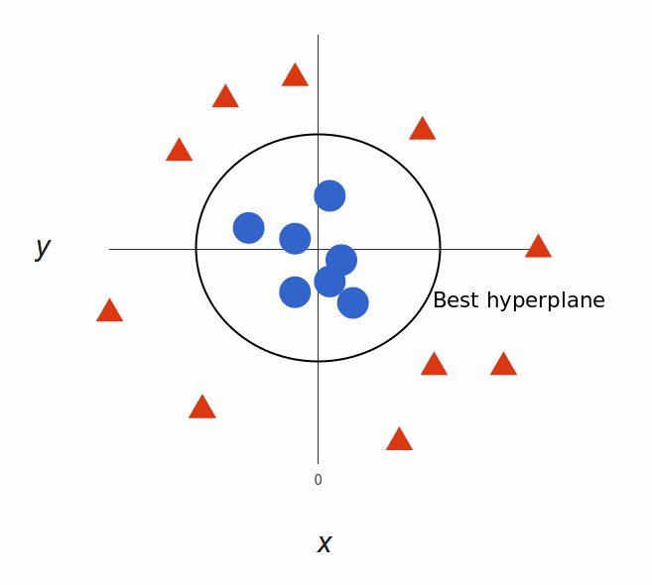
Best parameters after adding the new dimension

Slide 16
Intuition of SVM

Slide 18
Hands-On

Slide 19
Pros of SVM
It works really well with a clear margin of separation
It is effective in high dimensional spaces.
It is effective in cases where the number of dimensions is greater than the number of samples.
It uses a subset of training points in the decision function (called support vectors), so it is also memory efficient.

Slide 20
Cons of SVM
It works really well with a clear margin of separation.
It doesn’t perform well when we have large data set because the required training time is higher
It also doesn’t perform very well, when the data set has more noise i.e. target classes are overlapping
SVM doesn’t directly provide probability estimates, these are calculated using an expensive five-fold cross-validation. It is included in the related SVC method of Python scikit-learn library

